Slide 1
Freight Estimator Model Analysis Cannon Johnson

Slide 2
Model Objective
The model was aimed to better estimate freight cost to customers without utilizing weight as a predictor variable.
The model should be able to estimate freight cost for specific equipment type (FTD, LTL, Van) using the data provided.
The goals is for customers and the company to have less problems with under/over quoting freight.

Slide 3
Exploratory Data Analysis
Base datasheet with ~ 14,000 observations and features such as seller and customer zip, zoning, and total billed.
Data was downloaded from the web totaling all us cities zip-codes to map the freight ariel distance for each observation
Since the data will be split later, only missing values were cleaned
Data is split by the feature equipment and imported into Rstudio for visualization and modeling.

Slide 4
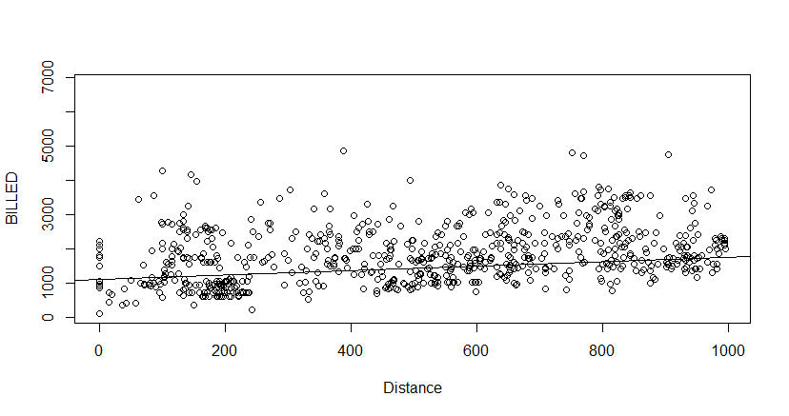
FTD model results
FTD contains 921 observations and regression was done on two separate groups.
Separation on FedEx Zoning for ease of clustering
Lm(BILLED ~ Distance , data = FTLO)
While the model p-value is significant, the error rate is very high

Slide 5
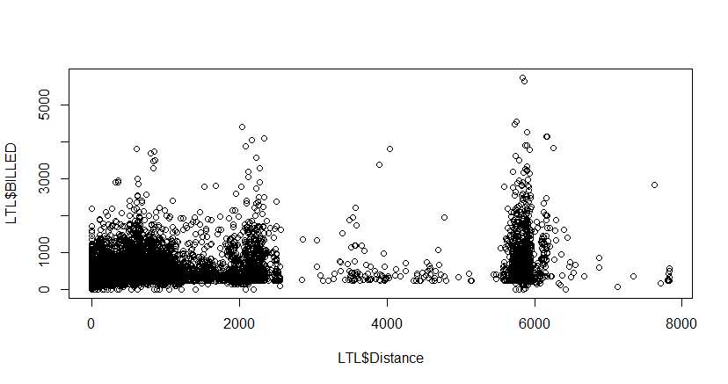
LTD model results
FTD contains 13831 observations with a wide variation in distance
The distance was the main challenge for this equipment resulting in multiple model attempts
‘Weight’ and ‘BILLED’ have a strong correlation but due to the model request were purposely left out but included in the code
To combat the distance issue, the models were split by FedEx Zone when applicable

Slide 6
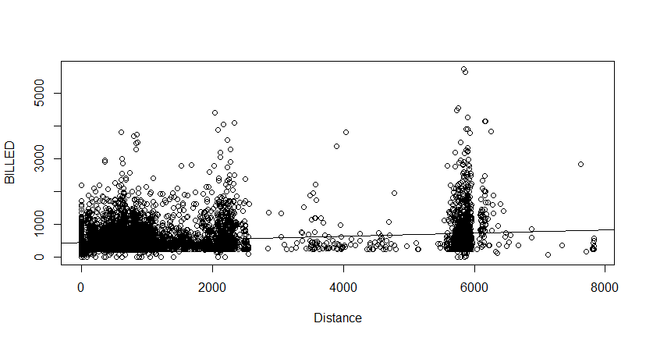
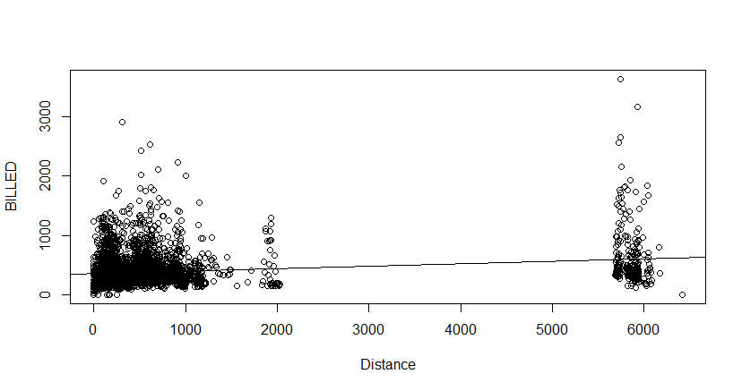
LTD model results
*NOTE: liner regression plot Zone 1(2,3) on left and Zone 2(4,5,6,7) on right

Slide 7
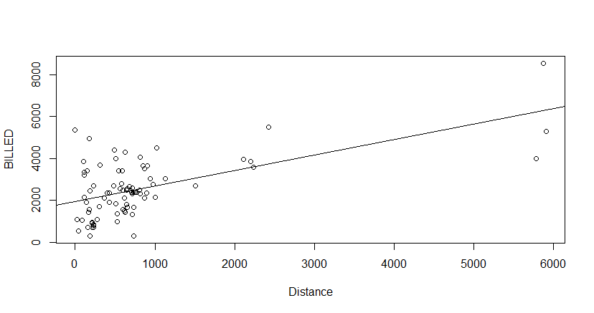
Van model results
The Van equipment group is the smallest subset with 86 observations
‘Distance’ and ‘BILLED’ is moderately correlated
The Van model produces the best visual for liner regression due to this correlation

Slide 8
Conclusion
The best performing model was for the Van equipment type due to the correlation between the price and the low variation in distance. The other models struggled for too much variation in distance, lack of predictor variables, or outlier in clustering due to varying subsets. The current data and model guidelines do give the model success in predicting freight cost.
Comment on Error and p-values
The over p-value of the models and coefficients were significant enough to note, but the error was much higher than expected. My speculation is that the company may have incentives for specific weight that I am not capturing. The idea that billed cost is including numbers other than freight cost such as tax but also discounts. There are many others that I could consider, but the current state of the data does not allow for accurate estimations with liner regression.

